Slide 1
FTP , GOOGLE , YAHOO , E-MAIL
Presented by: Ikshu Gyawali & Sabita Subedi

Slide 2
GOOGLE

Slide 3
INTRODUCTION
American multinational technology company.
Specializes in Internet-related services and products.

Slide 4
HISTORY

Slide 5
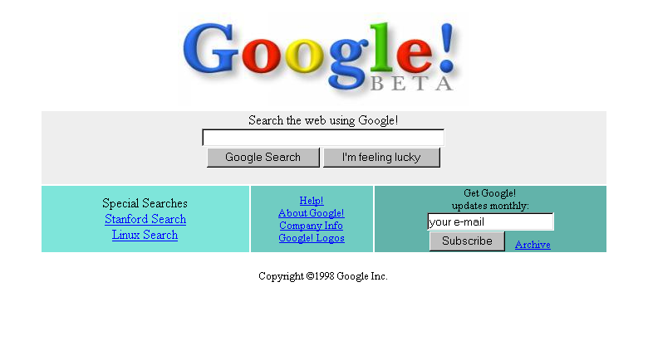
History cntd.
Founded in 1998 by Larry Page and Sergey Brin.

Slide 6


History cntd.
In 1999, Google redesigned the logo
In 2000, Google AdWords was created
Quick and easy way for business to advertising online

Slide 7

GOOGLE Images
History cntd.
Launched International office in Tokyo and Japan(2001)
Introduced Google images with 250M images.

Slide 8

GOOGLE news
History cntd.
•
•
In 2002, Google news was launched with 4,000 news resources online.

Slide 9

GMAIL
History cntd.
In 1st Apr 2004, Gmail goes live started with 1GB storage space.

Slide 10

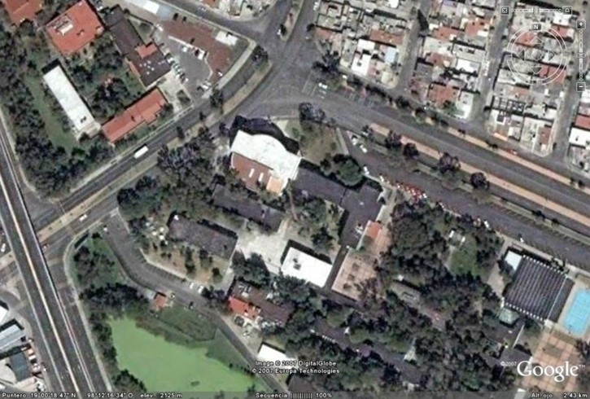
In 2005, Google maps was created Google talk was launched.
GOOGLE maps
History cntd.

Slide 11


Youtube
History cntd.
In 2006, Youtube joined Google
•
•

Slide 12

GOOGLE CHROME
•
•
•
In 2008, Google introduced one web browser.
•
Named Google chrome Faster, easier and safer

Slide 13

GOOGLE +
•
•
•
In 2011, Google launced Google plus It is a social networking service.

Slide 14
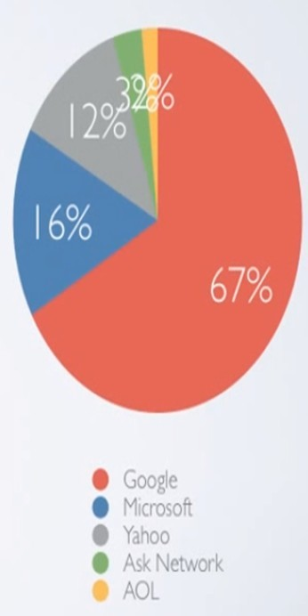
Market Share

Slide 15
YAHOO!

Slide 16
INTRODUCTION
Yet Another Hierarchical Officious Oracle.
Yahoo is an American web services provider.
Founded by Jerry Yang and David Filo in January 1994.
One of the pioneers of the early Internet era in the 1990s.

Slide 17
HISTORY
1995 – Yahoo incorporated
1996 – YAHOO GOES PUBLIC
1997 – News delivery service, people-searching, Online gaming and e-mail.
1999 – Aggressive growth strategy, providing more content, features and services such as web hosting, internet radio etc.

Slide 18
History
Contd.
2000 - Yahoo began using Google for search.
2001-Yahoo! Inc. rose to stardom being the second most popular name on the Internet after AOL.
2007- Yahoo began to offer unlimited email storage.
2012 Yahoo sold the shares held in Alibaba.
2016 Yahoo owns a meager 15% of Alibaba, which alone is worth $30 billion.

Slide 19
PRODUCTS AND SERVICES
Social Networking Yahoo mail, yahoo messenger, My Web, Flickr, Delicious
Mobile Services Yahoo Mobile, OneSearch
Advertising Yahoo Search Marketing
Small Business Yahoo DomainKeys, Yahoo web Hosting, Yahoo Merchant Solutions

Slide 20
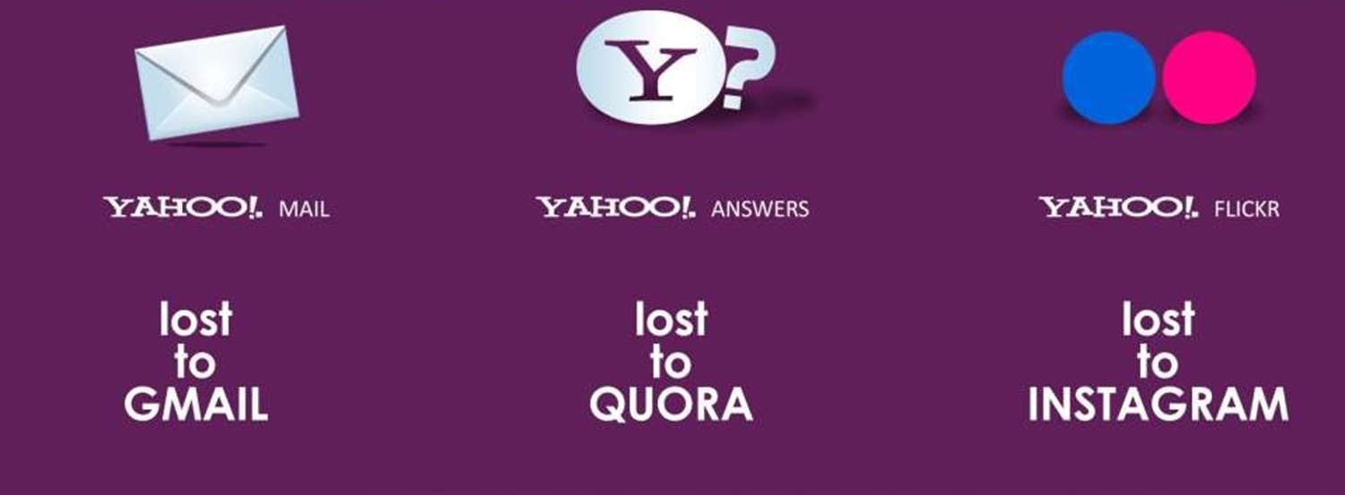
REASON FOR DOWNFALL OF YAHOO
Bad Acquisitions and Stronger Competition
The damage from too many bad deals failed to lift Yahoo from the ongoing crisis.
It was evident; Yahoo was making too many bad decisions year after year.

Slide 21

July 2016 – The Wrap Up!
Verizon Buys Yahoo for $4.8 billion

Slide 22
E-MAIL

Slide 23
What is E-MAIL ?
E-mail ( Electronic Mail):method of exchanging digital message
Based on STORE & FORWARD model

Slide 24
History
Foundation for today’s global internet services created in the early ARPANET
E-mail send in early 1970s looks very similar to one send on internet today
Network based email was initially exchanged on the ARPANET in extension to FTP
Today carried out with the extension by SMTP

Slide 25
WHY TO USE E-MAIL ?
Fast compared to postal mail
Send message anytime anywhere even to several people at same time in different corners
Easy to edit and return revised version
Easy sending and receiving document within a minute

Slide 26
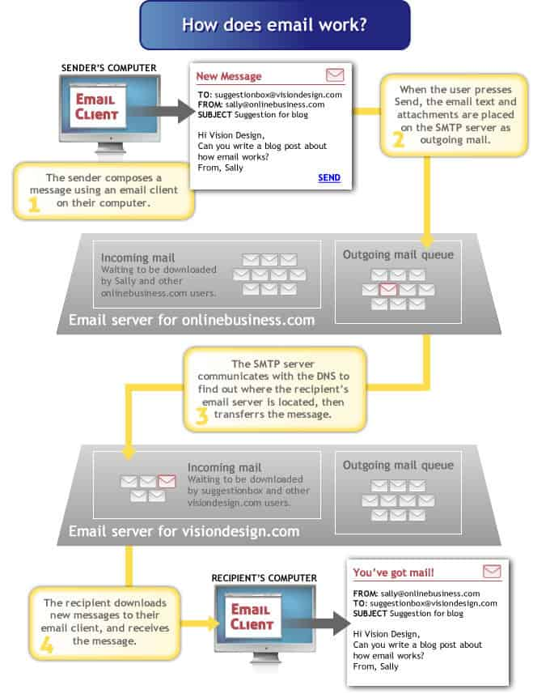

Slide 27
FTP (FILE TRANSFER PROTOCOL)

Slide 28
WHAT IS FTP ?
Application layer protocol which moves files between local and remote file systems.
Runs on the top of TCP, like HTTP
To transfer a file, 2 TCP connections are used by FTP in parallel

Slide 29
How does ftp works ?

Slide 30
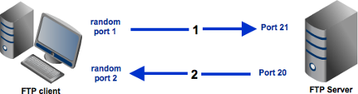
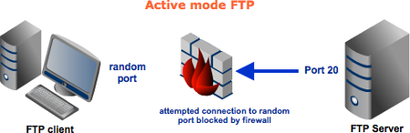
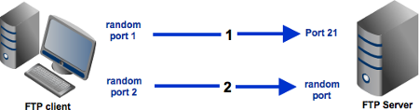

Slide 31
Why this old protocol still matters ?
Transfer data files between a client and a server over a computer network
Developed in the early 1970s by student at MIT
Secure transfer of files between servers and host computers over the ARPANET Network Control Program
Continued to evolve
Growing concerns over security

